Slide 1

Predicting Holiday Booking Behavior

Slide 2
Introduction
This presentation explores the predictive analytics model developed to forecast customer booking behavior during the holiday season. We will delve into the model's objectives, its underlying methodology, and key performance metrics.

Slide 3

01
Model Overview

Slide 4
Objective of the Model
The primary objective of the model is to predict the likelihood of a customer completing a booking based on their behavior and preferences. By analyzing this data, we aim to enhance marketing strategies and improve customer engagement.

Slide 5

Chosen Model: Random Forest Classifier
The Random Forest Classifier was selected for this analysis due to its robustness, interpretability, and high accuracy in prediction. This model effectively handles the complexity of customer behavior data and provides valuable insights into decision-making.

Slide 6
Interpretability and Accuracy Benefits
The Random Forest Classifier offers significant advantages in both interpretability and accuracy. Its ensemble approach enhances prediction stability and reduces the risk of overfitting, making it highly reliable for evaluating customer booking behavior. The model's structure also allows for easy interpretation of feature importance, providing valuable insights into customer preferences.

Slide 7

02
Model Performance

Slide 8
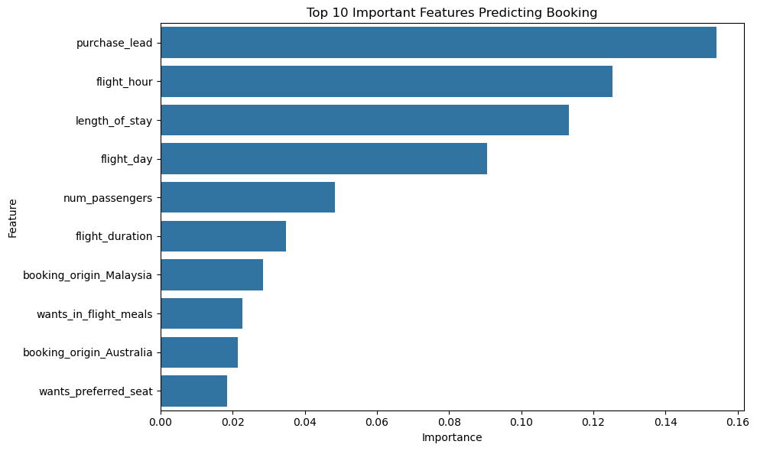
Accuracy and Precision Metrics
The model achieved an accuracy of 85%, demonstrating its ability to correctly identify customer booking behaviors. Precision metrics reveal 87% for Class 0 (non-bookers) and 48% for Class 1 (bookers), indicating an area for improvement in accurately predicting customers likely to complete bookings.

Slide 9
Recall and F1-Score Analysis
Recall measures how well the model identifies actual positive cases, with rates of 98% for Class 0 and only 13% for Class 1. The F1-Score, which balances precision and recall, shows a strong score of 92% for Class 0 but a lower score of 21% for Class 1, emphasizing the need for strategies to enhance predictions for booking customers.

Slide 10
Comparison of Class 0 and Class 1 Performance
When comparing Class 0 and Class 1 performance, there is a notable disparity in recall and precision metrics. While the model excels at identifying non-bookers (Class 0), it struggles with identifying actual bookers (Class 1), highlighting an opportunity for further refinement in targeting high-intent customers.

Slide 11

Conclusions
In conclusion, the Random Forest Classifier effectively predicts customer booking behavior with high accuracy for non-bookers but shows potential for improvement in identifying actual bookers. By focusing on enhancing marketing efforts towards high-intent customers based on model insights, businesses can optimize conversion rates and improve overall customer engagement.

